Slide 1


Introduction of Enterprise Resource Planning

Slide 2
Chapter’s content
Modern management leads for ERP
Problems in functional management
Information management system and the evolution of ERP
Necessities, benefits and difficulties in executing ERP
General ideas of business process
Components of ERP
Layered structures of ERP

Slide 3
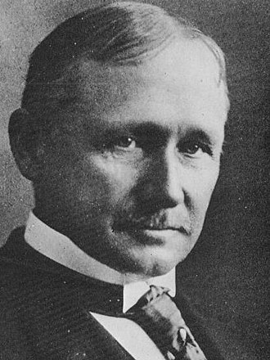
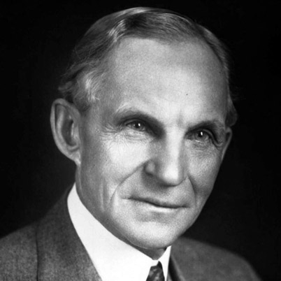
1. Modern management leading for ERP
Frederick W. Taylor
(1856 - 1915)
Henry Ford
(1856 - 1915)

Slide 4
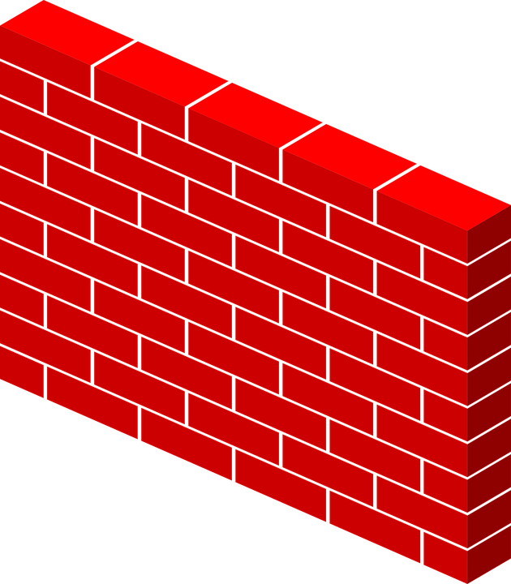
1. Modern management leading for ERP
Scientific management aka “Taylorism” idea
Function A
Function B
Function C

Slide 5

2. Problems in functional management
Each department is a castle
Production
Marketing
Sales
HR

Slide 6


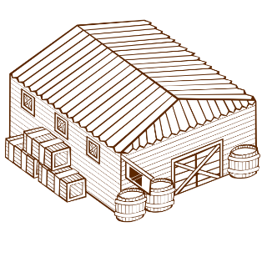

Late in business process
Create/update documents
Receive order
Late
Seller
Late
transport
Prepare goods
Warehouse manager
Create/update documents
Late
Export goods
Late
transport
Export and send invoice
Create/update documents
Accountant
Late
Receive payment

Slide 7
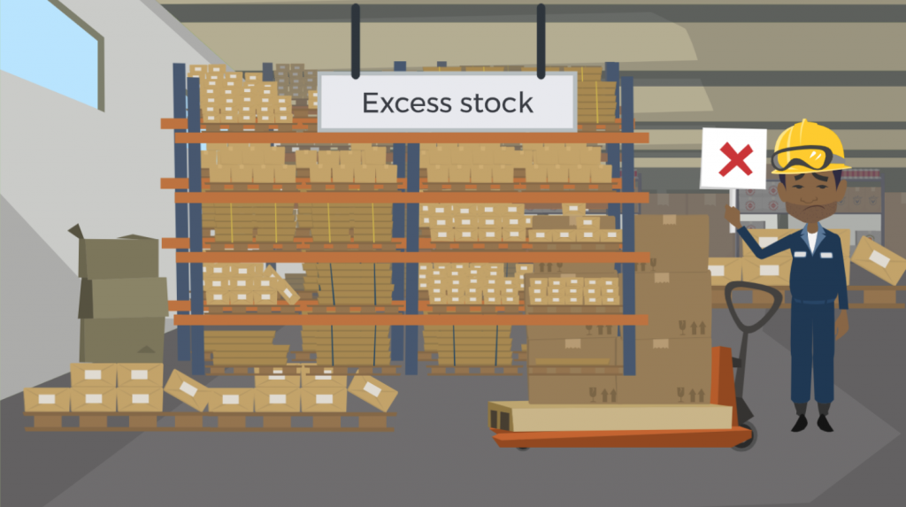
Excessive Inventory

Slide 8
Lack of consistent information between departments
Information here is the “status” of the process, or how well the process goes…

Slide 9

Local optimization
Each department has its own goal, achieving goal is a life or death aspect of a department.
Small order with promise
of receiving on-time
Shipping cost increased if used FTL
Shipping cost decreased
Evaluating order
Use LTL, use boat to transfer
Too late for customer expectation!

Slide 10

3. Management information systems and the evolution of ERP
Stage I (1960 – 1970) DATA SYSTEM
2. Stage II (1980) FUNCTION SYSTEM
3. Stage III (1990) ERP
4. Stage IV (2000 -> now) EXTENDED ERD

Slide 11
1. Stage I (1960 – 1970) DATA SYSTEM
What does it take to make an ingredient?
When does production start?
what to do next?
materials planning
Product structure
Order

Slide 12
2. Stage II (1980) FUNCTION SYSTEM
Sales
warehouse manager
accountant
take customer orders
Prepare order
export
issue & send invoice
Receive order
Create / update document
Create / update document
Create / update document
Create / update document
Create / update document
Transfer document
Transfer document
sales information system
Accountant information system
warehouse information system

Slide 13
Closed Loop MRP
Inventory
order
production scheduling
Production plan
Main work
preliminary plan of production capacity
enough resources
no
yes
MRP
Additional functions of ERP
resource requirements planning
production
Buy material
A part of ERP
enough resources
no
purchasing department
factory

Slide 14
MRP II
goals
business plan
sales and production plan
needs, resources
Inventory
Order
Production plan
Main work
enough resources
no
yes
production schedule
products/services
enough resources
resource requirements planning
production
yes
MRP
component
enough resources
Additional functions of MRP II
Buy material
no
yes
purchasing department
A part of Closed Loop MRP
factory
Accountant

Slide 15
3. Stage III (1990) ERP
Sales
warehouse manager
accountant
take customer orders
Prepare order
export
issue & send invoice
Receive order
Create / update document
Create / update document
Create / update document
Create / update document
Create / update document
ERP
Process management with ERP

Slide 16
MRP
Closed Loop MRP
å
MRP II
ERP
Extend ERP

Slide 17
4. Necessity, benefits, and difficulties when implementing ERP
The necessity of implementing ERP
1. Eliminates data duplication and reduces the need for manual data entry and reconciliation.
2. Provides real-time access to critical business information.
3. Enhances collaboration and communication between different departments.

Slide 18
Benefits of implementing ERP 1. Improved productivity 2. Better decision-making 3. Enhanced collaboration 4. Reduced errors 5. Increased customer satisfaction …

Slide 19
Difficulties when implementing ERP 1. Cost 2. Complexity 3. Resistance to change 4. Data migration 5. Integration with existing systems

Slide 20
5. General ideas of business process

Slide 21
Material Planning
Production
Buy
Sell
Customer
Supplier
Warehouse and Material Management
Human resource
Research and Develop
Accounting

Slide 22
6. Components of ERP

Slide 23
ERP
Sale and Marketing
Master Scheduling
Shop Floor Control
Accounting
Purchasing
MRP
Logistics

Slide 24
7. Architectures of ERP

Slide 25
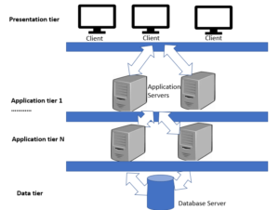
Multi-layer architecture

Slide 26
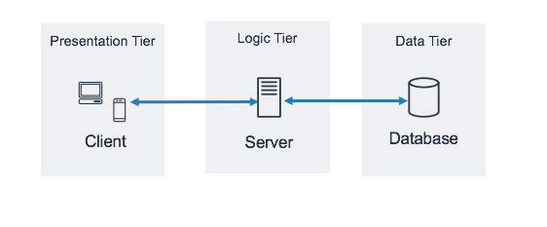
There-layer architecture

Slide 27
There-layer architecture

Slide 28
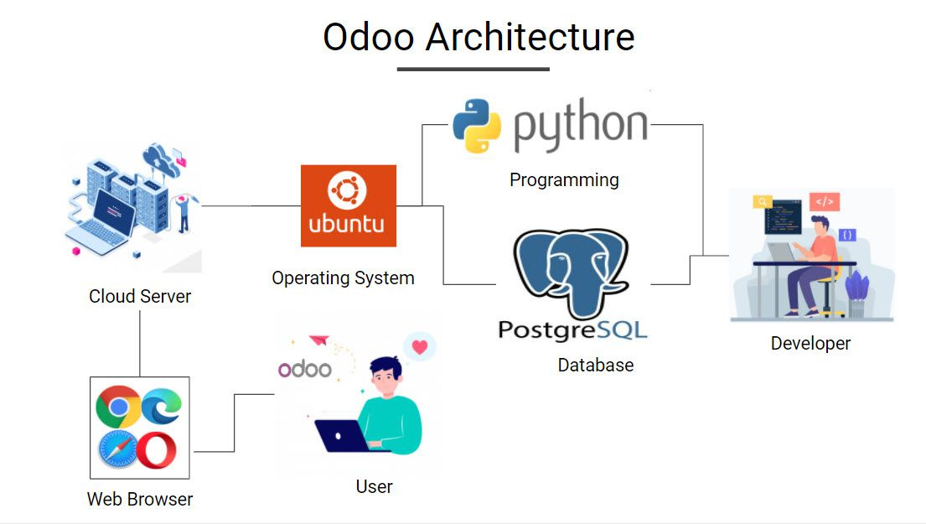

Slide 29
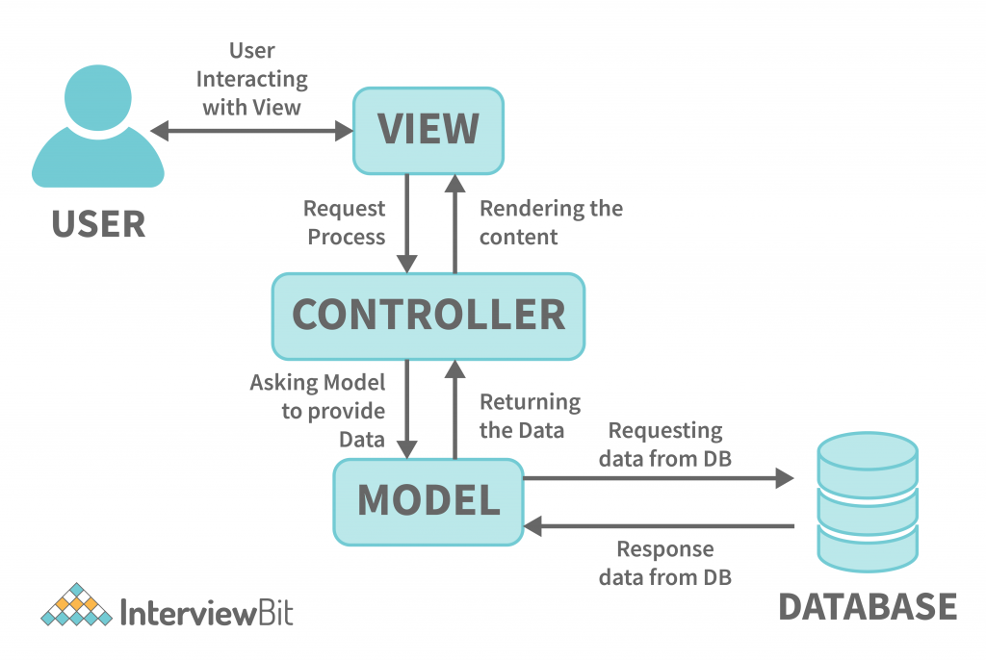
MVC architecture

